Slide 1


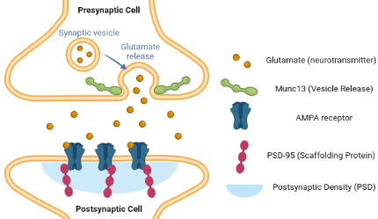
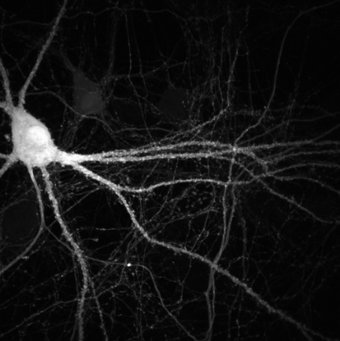
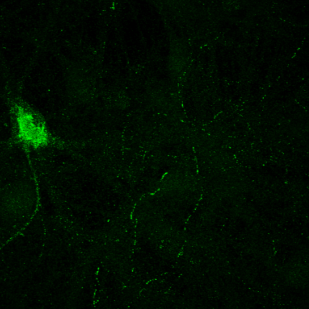
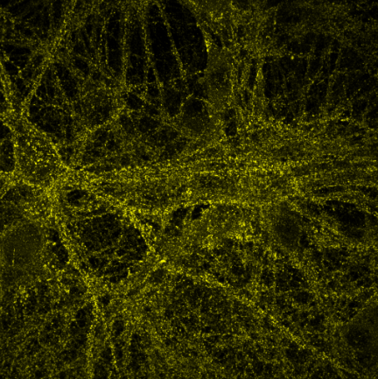
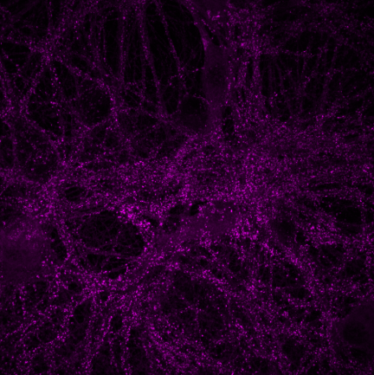
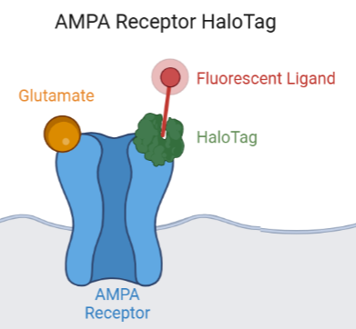
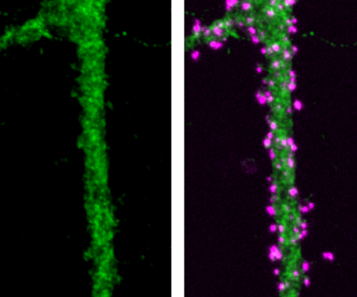
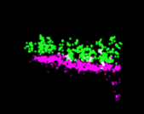
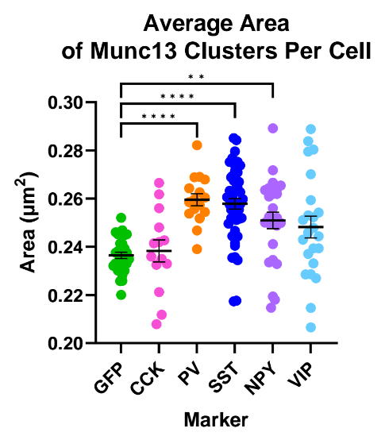
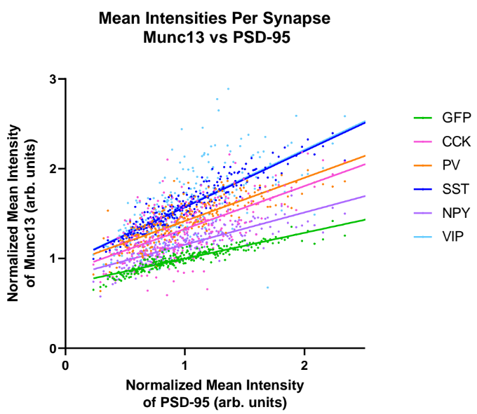
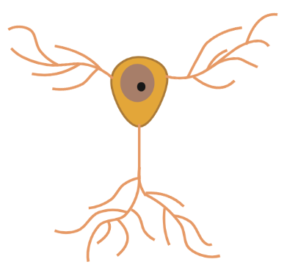
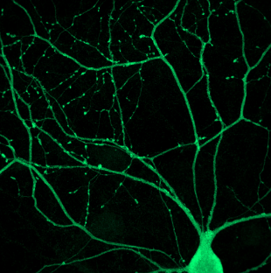
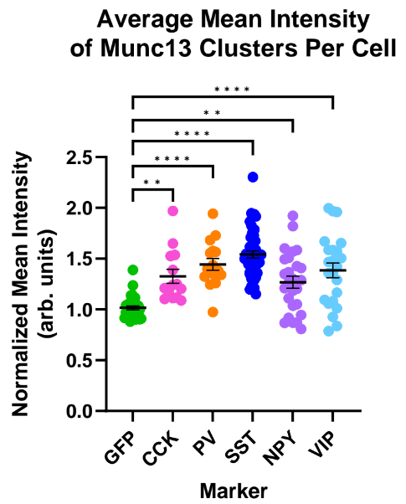
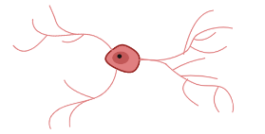
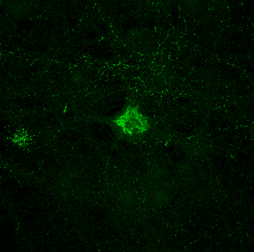
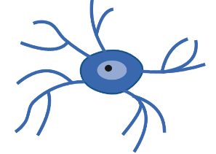
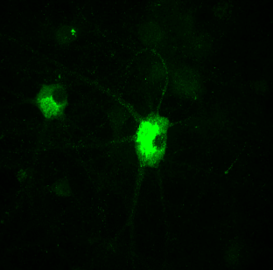
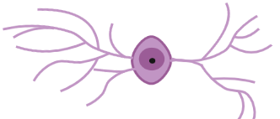
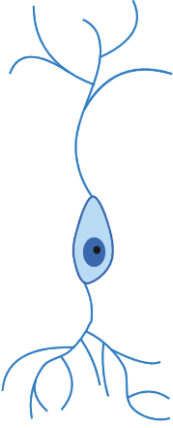
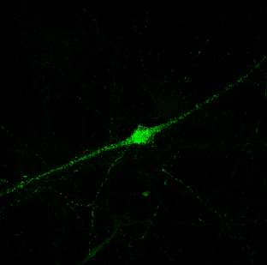
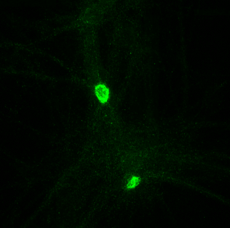
Diversity of Munc13 and PSD-95 Clusters at Synapses onto Inhibitory Neuron Subtypes
Diya Sharma¹ , Aaron Levy, PhD.², and Thomas A. Blanpied, PhD.²
¹Biotechnology Academy, Applications and Research Laboratory, ²University of Maryland, School of Medicine
Importance of Synaptic Protein Clusters
Understanding Synaptic Protein Organization
Experimental Materials and Methods
Discussion and Conclusion
Neurocognitive diseases, such as autism spectrum disorder, are associated with an irregular organization of key protein clusters at synapses^{[1]}. Postsynaptic density-95 (PSD-95) is a cluster-forming scaffolding protein that anchors neurotransmitter receptors in the postsynaptic density. Abnormal PSD-95 organization has been proven to underlie impaired cognition and intellectual disability. Mammalian uncoordinated-13 (Munc13) is another cluster-forming protein that is essential for neurotransmitter release in the presynaptic active zone. The size and intensity of both PSD-95 and Munc13 clusters are directly related to synaptic strength^{[2]}; however, the differences in organization across various synapse types is not well understood. Excitatory synapses containing these proteins are made onto both excitatory neurons, which promote neural activity, and inhibitory neurons, which prevent excessive activity. Therefore, researching the differences between protein clusters at excitatory synapses onto excitatory neurons (Ex→Ex) and at excitatory synapses onto inhibitory neurons (Ex→Inh) is crucial for understanding synaptic transmission and identifying abnormal synaptic behavior.
Lab goal: To investigate the role of subsynaptic protein organization in synaptic transmission using rat hippocampal neurons and super resolution microscopy.
Infect rat hippocampal neuron cultures with a viral vector carrying an inhibitory specific BFP that visualizes entire neuron. An excitatory specific GFP virus was used as a control.
The area of Munc13 clusters is significantly greater in excitatory synapses onto three of the inhibitory neuron subtypes (Avg: 0.26 µm^²) compared to Ex→Ex synapses (0.24 µm^²). Similarly, Munc13 cluster intensity is on average 1.39 times greater in all Ex→Inh synapses compared to Ex→Ex synapses. PSD-95 clusters had little to no significance difference between neurons. The results indicate larger and denser Munc13 clusters in Ex→Inh synapses compared to Ex→Ex synapses. The ratio of Munc13 to PSD-95 is also statistically different between inhibitory neuron subtypes, suggesting unique protein organization among those subtypes.
Certain factors, such as the method for cell type selection, were not ideal due to a significant proportion of cells that express more than one marker (table 1). A Cre-driver mouse line would allow for cell-specific genetic expression and improved accuracy. Furthermore, variability among CCK neurons can be addressed by increasing the sample size in future experiments (table 2).
The correlation between Munc13 cluster area/intensity and synapse type establishes a foundation for future experiments that aim to understand protein organization at synapses. Such research could help identify molecular abnormalities related to synaptic protein clustering that are associated with neurocognitive diseases.
Project goal: To identify the proportions of inhibitory neuron subtypes in rat hippocampal cultures and measure the area/intensity of Munc13 and PSD-95 clusters at excitatory synapses onto various inhibitory neuron subtypes using immunostaining and confocal microscopy.
Neuron Proportions
Synaptic Analysis
Use immunocytochemistry to stain for neuron nuclei and five inhibitory neuron subtype markers (fig 2.)
Use immunocytochemistry to stain for Munc13, PSD-95, and five inhibitory neuron subtype markers (fig 2.)
Hypothesis:
Munc13 is more dense at excitatory synapses onto parvalbumin-expressing (PV) neurons than at Ex→Ex synapses, as shown by prior research.
Different inhibitory neuron subtypes have unique roles in neuronal circuits, so the Munc13 organization at excitatory synapses onto different inhibitory neuron subtypes will vary.
Image coverslip at 20x and count marker positive cells using automatic program
Image infected and marker positive cells at 60x and measure area/intensity of Munc13 and PSD-95
Results: Larger and Denser Munc13 Clusters in Ex→Inh Synapses, but Variable Munc13 to PSD-95 Ratios Among Inhibitory Neuron Subtypes
Table 1. Cell Type Percentages
a)
BFP
b)
SST
c)
Munc13
d)
PSD-95
Subtype Marker | Average Percentage Per Coverslip
Inhibitory Targeting BFP | 10.74%
Cholecystokinin (CCK) | 7.55%
Parvalbumin (PV) | 4.95%
Somatostatin (SST) | 2.85%
Neuropeptide Y (NPY) | 3.00%
Vasoactive intestinal peptide (VIP) | 3.20%
Both SST and NPY | 1.26%
Future Direction: HaloTag and DNA-Paint
In addition to Munc13 and PSD-95, study the organization of AMPA receptors by utilizing a previously developed HaloTag.
Use super resolution microscopy (DNA-paint) to determine the precise differences in Munc13, PSD-95, and AMPA receptor organization at Ex→Inh synapses compared to Ex→Ex synapses.
Figure 1. Munc13 and PSD-95 are known to form clusters in the presynaptic active zone and postsynaptic density, respectively. Cluster size and density is hypothesised to vary based on cell type.
Figure 3. a) The inhibitory specific BFP cell fill visualizes the neuron’s dendrites. b) The anti-SST antibody confirms the presence of the SST neuropeptide, identifying the inhibitory subtype (fig 2). c) Synaptic staining shows Munc13 clusters. d) Synaptic staining shows PSD-95 clusters. Taken at 60x.
DNA-Paint
Confocal microscopy
Utilizing Inhibitory Neuron Subtype Markers
870 nm
Inhibitory Neuron Type(s) | Antibody/ Neuropeptide Marker | Probable Morphology | Staining
Axo-axonic and PV-expressing basket cells | Anti-Parvalbumin (PV)
CCK-expressing basket cells/ CCK interneurons | Anti-Cholecystokinin (CCK)
Oriens lacunosum- moleculare interneurons | Anti-Somatostatin (SST)
Neurogliaform and ivy cells | Anti-Neuropeptide Y (NPY)
Interneuron selective interneurons | Anti-Vasoactive Intestinal Peptide (VIP)
(a)
(b)
(c)
(SST, VIP)
1100 nm
Created in BioRender.com
Table 2. Sample Sizes for Synaptic Analysis
* * *
* * * * *
(PV, CCK)
In PV-expressing neuron:
Green - Munc13
Magenta - PSD-95
HaloTag
(NPY)
GFP 60x
Subtype Marker | Total Number of Cells Analyzed | Total Number of Synapses Analyzed
GFP | 30 | 11519
CCK | 14 | 1112
PV | 16 | 2769
SST | 47 | 6251
NPY | 26 | 4015
VIP | 23 | 1619
References
[1] Volk, L., Chiu, S. L., Sharma, K., & Huganir, R. L. (2015). Glutamate synapses in human cognitive disorders. Annual review of neuroscience, 38, 127–149. https://doi.org/10.1146/annurev-neuro-071714-033821
[2] Chen, H., Tang, A. H., & Blanpied, T. A. (2018). Subsynaptic spatial organization as a regulator of synaptic strength and plasticity. Current opinion in neurobiology, 51, 147–153. https://doi.org/10.1016/j.conb.2018.05.004
[3] Pelkey, K. A., Chittajallu, R., Craig, M. T., Tricoire, L., Wester, J. C., & McBain, C. J. (2017). Hippocampal GABAergic Inhibitory Interneurons. Physiological reviews, 97(4), 1619–1747. https://doi.org/10.1152/physrev.00007.2017
Figure 4. Average area (a) and intensity (b) of Munc13 clusters collected from confocal images is compared by synapse subtypes shown in figure 2. Asterisk (*) identifies a significant increase compared to Ex→Ex (GFP). a) Mean ± SEM = PV: 0.26 ± 0.003 µm^², SST: 0.26 ± 0.002 µm^², NPY: 0.25 ± 0.003 µm^². GFP: 0.24 ± 0.001 µm^² b) Mean ± SEM normalized to GFP = CCK: 1.33 ± 0.07, PV: 1.44 ± 0.06, SST: 1.54 ± 0.04, NPY: 1.27 ± 0.06, VIP: 1.38 ± 0.07, GFP: 1.02 ± 0.02. c) Munc13 intensity graphed against PSD-95 intensity indicates SST and VIP, PV and CCK, and NPY have statistically different protein ratios.
Figure 2. Hippocampal inhibitory neurons are classified by function, location of origin, types of neurons they target, etc^{[3]}. Neuropeptides are commonly used as markers for such cell types.
Acknowledgements
Special thanks to the members of the Blanpied Lab, Ms. Kelly, Huda, and Erik for their support and encouragement.
Notes:
https://app.biorender.com/illustrations/643dac28233971014fa3f36f

